Slide 1


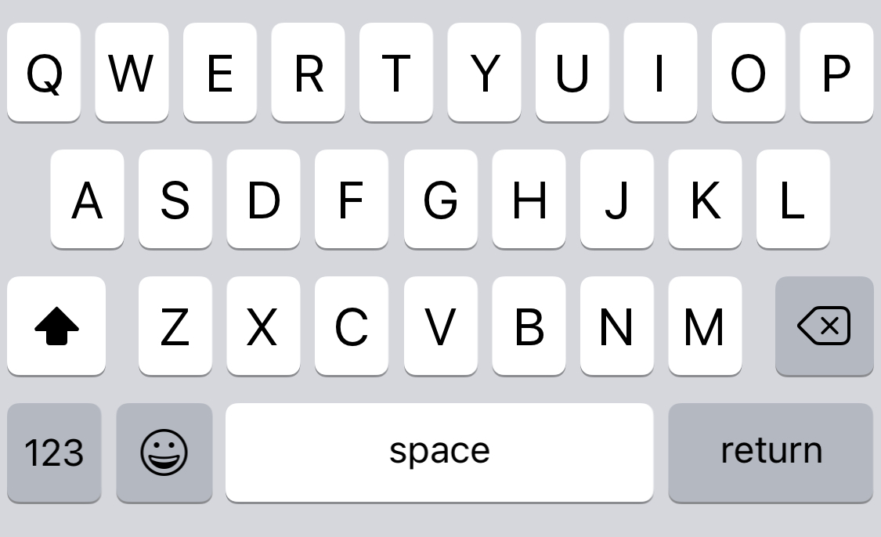
To:
Mya
Hi Michael !!!
Mya is working. Say hi to engage and check here for content.
Enter presentation mode for the optimal experience.
Click to traverse (or press →)
hello

Slide 2


To:
Mya
hello
Hi Michael !!!
Mya is working. Say hi to engage and check here for content.
Enter presentation mode for the optimal experience.
Click to traverse (or press →)
Bot is typing…

Slide 3


To:
Mya
hello
Hi Michael !!!
Hi! I’m Mya, Michael Yen’s assistant. What’s your name?
Hi Michael !!!
Hi Michael !!!
Hi Michael !!!
Hi Michael !!!
Hi Michael !!!
Yannell

Slide 4
To:
Mya
hello
Hi! I’m Mya, Michael Yen’s assistant. What’s your name?
Hi Michael !!!
Hi Michael !!!
Hi Michael !!!
Hi Michael !!!
Hi Michael !!!
Mx. Smiley
Bot is typing…

Slide 5

To:
Mya
hello
Hi! I’m Mya, Michael Yen’s assistant. What’s your name?
Hi Michael !!!
Hi Michael !!!
Hi Michael !!!
Hi Michael !!!
Mx. Smiley
It’s a pleasure to meet you Mx. Smiley! I can help you navigate through Michael’s portfolio while he builds other bots. What would you like to know first?
…tell me a little about Michael?

Slide 6
To:
Mya
hello
Hi! I’m Mya, Michael Yen’s assistant. What’s your name?
Hi Michael !!!
Hi Michael !!!
Hi Michael !!!
Mx. Smiley
It’s a pleasure to meet you Mx. Smiley! I can help you navigate through Michael’s portfolio while he builds other bots. What would you like to know first?
Thanks Mya! Can you tell me a little about Michael?
Bot is typing…

Slide 7

To:
Mya
hello
aBots me
Hi! I’m Mya, Michael Yen’s assistant. What’s your name?
Hi Michael !!!
Hi Michael !!!
Mx. Smiley
Having written a novel, a novella, poems, and screenplays, one could say that writing has always been a pastime of mine. Transitioning to bots in the workplace was natural, not because of the writing, but because of the commonality between creative expression and human/bot interactions—the human connection.
It’s not just about designing for bots; it’s about designing for people.
It’s a pleasure to meet you Mx. Smiley! I can help you navigate through Michael’s portfolio while he builds other bots. What would you like to know first?
Thanks Mya! Can you tell me a little about Michael?
Sure thing! Here’s a little blurb about Michael and bots.
tell me about his work on bots

Slide 8
To:
Mya
hello
aBots me
Hi! I’m Mya, Michael Yen’s assistant. What’s your name?
Hi Michael !!!
Mx. Smiley
Having written a novel, a novella, poems, and screenplays, one could say that writing has always been a pastime of mine. Transitioning to bots in the workplace was natural, not because of the writing, but because of the commonality between creative expression and human/bot interactions—the human connection.
It’s not just about designing for bots; it’s about designing for people.
It’s a pleasure to meet you Mx. Smiley! I can help you navigate through Michael’s portfolio while he builds other bots. What would you like to know first?
Thanks Mya! Can you tell me a little about Michael?
Sure thing! Here’s a little blurb about Michael and bots.
tell me about his work on bots
Bot is typing…

Slide 9
To:
Mya
hello
Hi! I’m Mya, Michael Yen’s assistant. What’s your name?
Hi Michael !!!
Row Your Bot Gently to the Screen
Mx. Smiley
It’s a pleasure to meet you Mx. Smiley! I can help you navigate through Michael’s portfolio while he builds other bots. What would you like to know first?
Yahoo bots stemmed from an experimental bot that acted as a personal assistant. As an original team member, I imitated a bot that imitated a person to assist users with everything from making restaurant reservations to shopping for presents. In short, there was no bot.
After gathering enough conversation data, the process of machine learning began by defining user intents, mostly through query tagging. The assistant bot was implemented from this effort and at this stage, I acted as an agent, taking over the bot when it didn’t understand a query or got stuck in a loop.
The assistant bot splintered into several different bots soon after, performing specialized functions. Each bot required a unique voice, tailoring to its targeted demographic. The goal was to create a positive experience using personality, not just successful story arcs and bot functions.
Thanks Mya! Can you tell me a little about Michael?
Sure thing! Here’s a little blurb about Michael and bots.
tell me about his work on bots
Got bots on your mind, do you? Here’s a brief summary of what Michael has done.
any other relevant experience?

Slide 10
To:
Mya
Hi! I’m Mya, Michael Yen’s assistant. What’s your name?
Mx. Smiley
It’s a pleasure to meet you Mx. Smiley! I can help you navigate through Michael’s portfolio while he builds other bots. What would you like to know first?
Row Your Bot Gently to the Screen
Yahoo bots stemmed from an experimental bot that acted as a personal assistant. As an original team member, I imitated a bot that imitated a person to assist users with everything from making restaurant reservations to shopping for presents. In short, there was no bot.
After gathering enough conversation data, the process of machine learning began by defining user intents, mostly through query tagging. The assistant bot was implemented from this effort and at this stage, I acted as an agent, taking over the bot when it didn’t understand a query or got stuck in a loop.
The assistant bot splintered into several different bots soon after, performing specialized functions. Each bot required a unique voice, tailoring to its targeted demographic. The goal was to create a positive experience using personality, not just successful story arcs and bot functions.
Thanks Mya! Can you tell me a little about Michael?
Sure thing! Here’s a little blurb about Michael and bots.
tell me about his work on bots
Got bots on your mind, do you? Here’s a brief summary of what Michael has done.
any other relevant experience?
Bot is typing…

Slide 11

To:
Mya
Yannell
It’s a pleasure to meet you Mx. Smiley! I can help you navigate through Michael’s portfolio while he builds other bots. What would you like to know first?
Thanks Mya! Can you tell me a little about Michael?
When I first arrived at Walmart Labs, I took my knowledge of query tagging and applied it to machine learning, via natural language processing, for search. I spearheaded the effort and helped design the evaluation process, then trained and led a team of five to correct previous data and tag new data. The task was then scaled out to include teams in India for increased production.
I moved to a different role, owning the feature development process for the search core team. I led stakeholder meetings to set expectations, trained crowdsourcing vendors for evaluation tasks, performed a/b testing analysis on evaluations, helped develop tools to maximize efficiency, and offered recommendations on all features based on data.
Sure thing! Here’s a little blurb about Michael and bots.
tell me about his work on bots
Got bots on your mind, do you? Here’s a brief summary of what Michael has done.
any other relevant experience?
Michael’s experience from Yahoo! translated to his time at Walmart Labs.
What bots did Michael work on at yahoo?

Slide 12
It’s a pleasure to meet you Yannell! I can help you navigate through Michael’s portfolio while he builds other bots. What would you like to know first?
To:
Mya
Thanks Mya! Can you tell me a little about Michael?
Sure thing! Here’s a little blurb about Michael and bots.
When I first arrived at Walmart Labs, I took my knowledge of query tagging and applied it to machine learning, via natural language processing, for search. I spearheaded the effort and helped design the evaluation process, then trained and led a team of five to correct previous data and tag new data. The task was then scaled out to include teams in India for increased production.
I moved to a different role, owning the feature development process for the search core team. I led stakeholder meetings to set expectations, trained crowdsourcing vendors for evaluation tasks, performed a/b testing analysis on evaluations, helped develop tools to maximize efficiency, and offered recommendations on all features based on data.
tell me about his work on bots
Got bots on your mind, do you? Here’s a brief summary of what Michael has done.
any other relevant experience?
Michael’s experience from Yahoo! translated to his time at Walmart Labs.
What bots did Michael work on at yahoo?
Bot is typing…

Slide 13
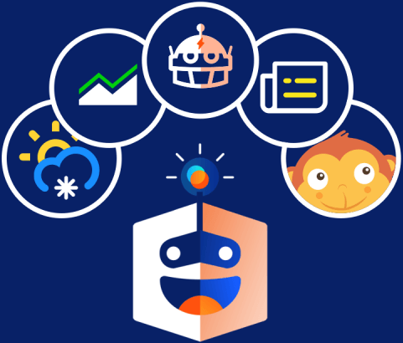
To:
Mya
Thanks Mya! Can you tell me a little about Michael?
Sure thing! Here’s a little blurb about Michael and bots.
Yahoo! Bots
tell me about his work on bots
Got bots on your mind, do you? Here’s a brief summary of what Michael has done.
I was fortunate to have worked on a multitude of bots at Yahoo!
Basketball Bot
News Bot
Weather Bot
Trivia/Game Bot
Interactive Bot
Finance Bot
Restaurant Bot
Movie Bot
Alarm clock Bot
Personal assistant Bot
any other relevant experience?
Michael’s experience from Yahoo! translated to his time at Walmart Labs.
What bots did Michael work on at yahoo?
Here are the bots Michael worked on during his time at Yahoo!
tell me about the basketball bot mya

Slide 14
To:
Mya
Sure thing! Here’s a little blurb about Michael and bots.
tell me about his work on bots
Yahoo! Bots
Got bots on your mind, do you? Here’s a brief summary of what Michael has done.
I was fortunate to have worked on a multitude of bots at Yahoo!
Basketball Bot
News Bot
Weather Bot
Trivia/Game Bot
Interactive Bot
Finance Bot
Restaurant Bot
Movie Bot
Alarm clock Bot
Personal assistant Bot
any other relevant experience?
Michael’s experience from Yahoo! translated to his time at Walmart Labs.
What bots did Michael work on at yahoo?
Here are the bots Michael worked on during his time at Yahoo!
tell me about the basketball bot mya
Bot is typing…

Slide 15
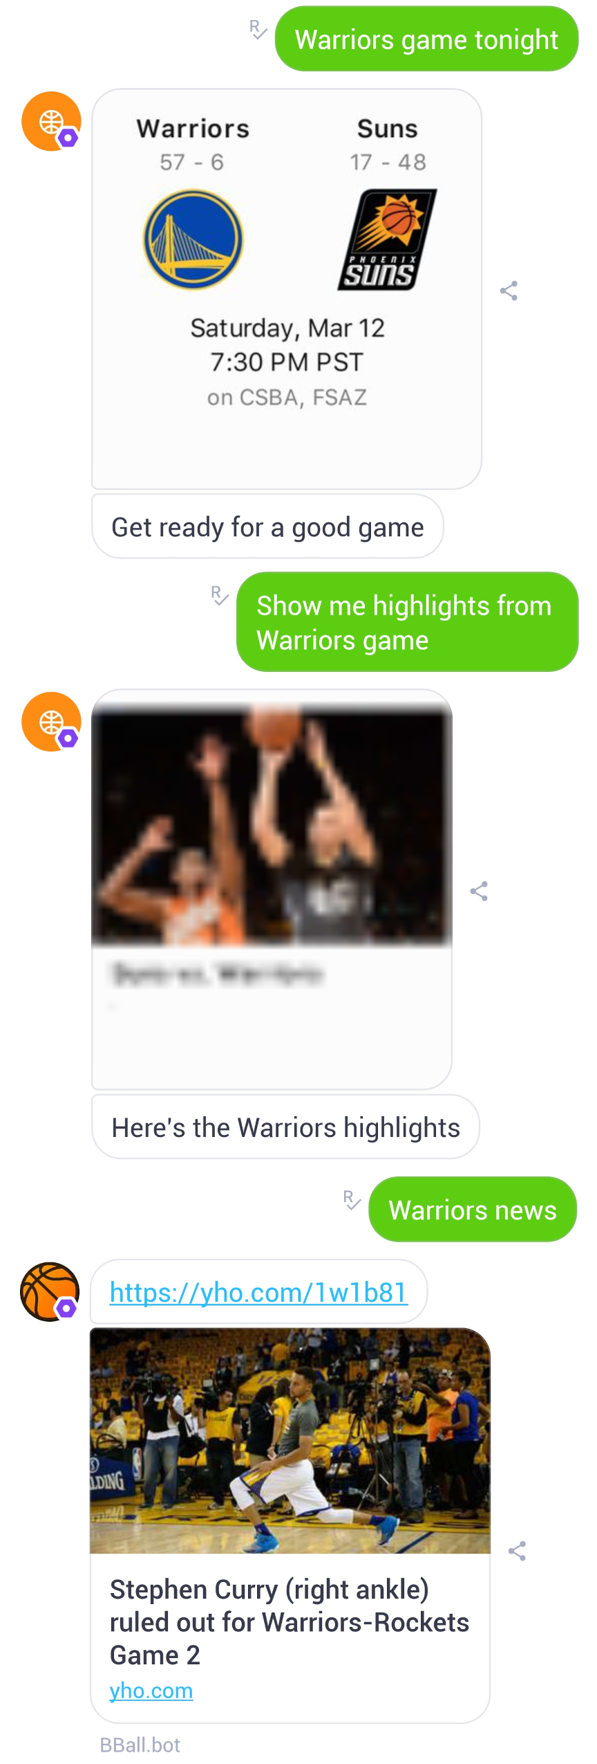
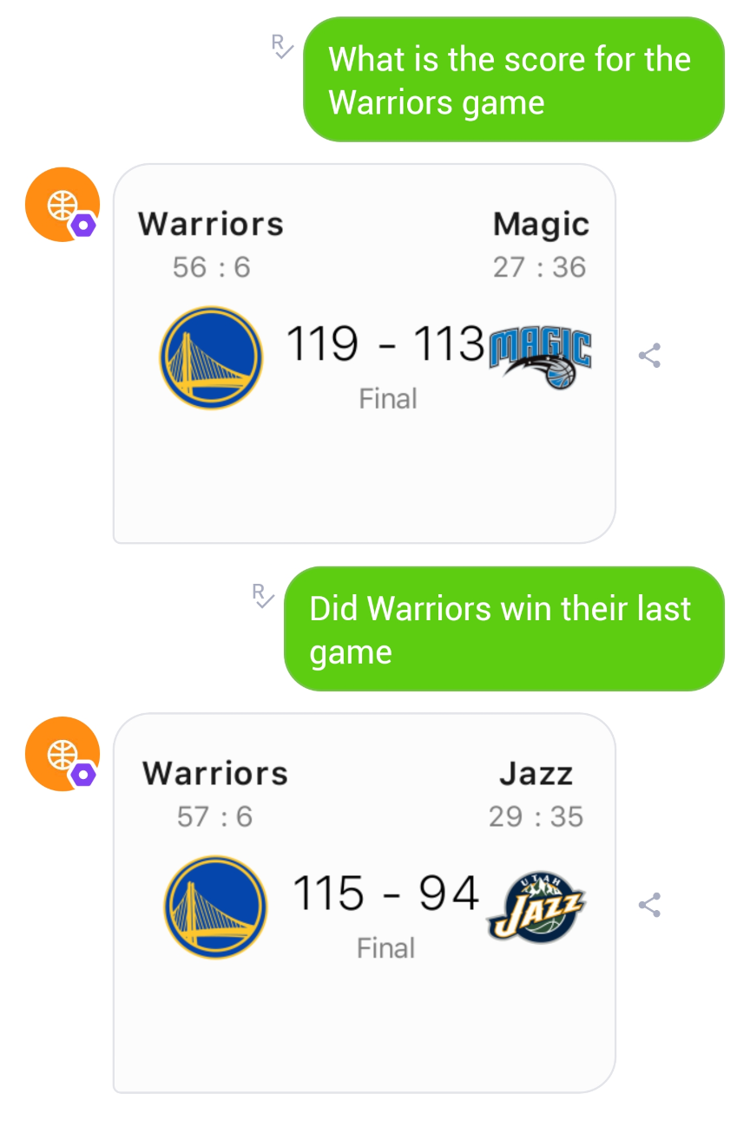
To:
Mya
Got bots on your mind, do you? Here’s a brief summary of what Michael has done.
any other relevant experience?
Bball Bot (1 of 4)
Michael’s experience from Yahoo! translated to his time at Walmart Labs.
Persona: Basketball focused and fun, utilizing basketball slang and verbiage.
Functions:
Scores and results
News and highlights
Game notifications
Team and player stats
Head to head comparisons
Quizzes
Conversation
  Steering towards NBA when needed
Examples:
Scores
Notifications, Highlights, News
What bots did Michael work on at yahoo?
Here are the bots Michael worked on during his time at Yahoo!
tell me about the basketball bot mya
You remembered my name! How flattering! Check out Michael’s stat line for the Bball Bot; he did a bit of everything!

Slide 16
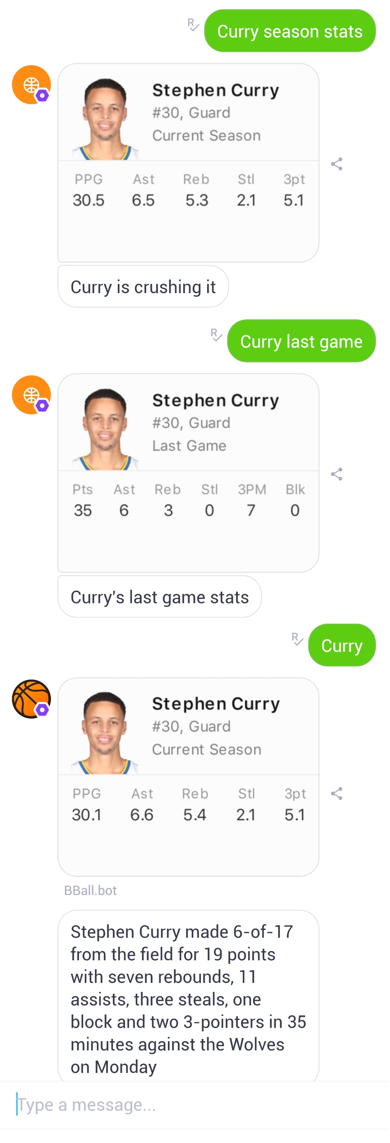
To:
Mya
Got bots on your mind, do you? Here’s a brief summary of what Michael has done.
any other relevant experience?
Bball Bot (2 of 4)
Michael’s experience from Yahoo! translated to his time at Walmart Labs.
Example:
The Stephen Curry example highlights how the bot differentiated between types of stats, based on recognized tokens or phrases. Curry, as a query by itself, brought about the default for season stats, then provided tidbits.
What bots did Michael work on at yahoo?
Here are the bots Michael worked on during his time at Yahoo!
tell me about the basketball bot mya
You remembered my name! How flattering! Check out Michael’s stat line for the Bball Bot; he did a bit of everything!

Slide 17
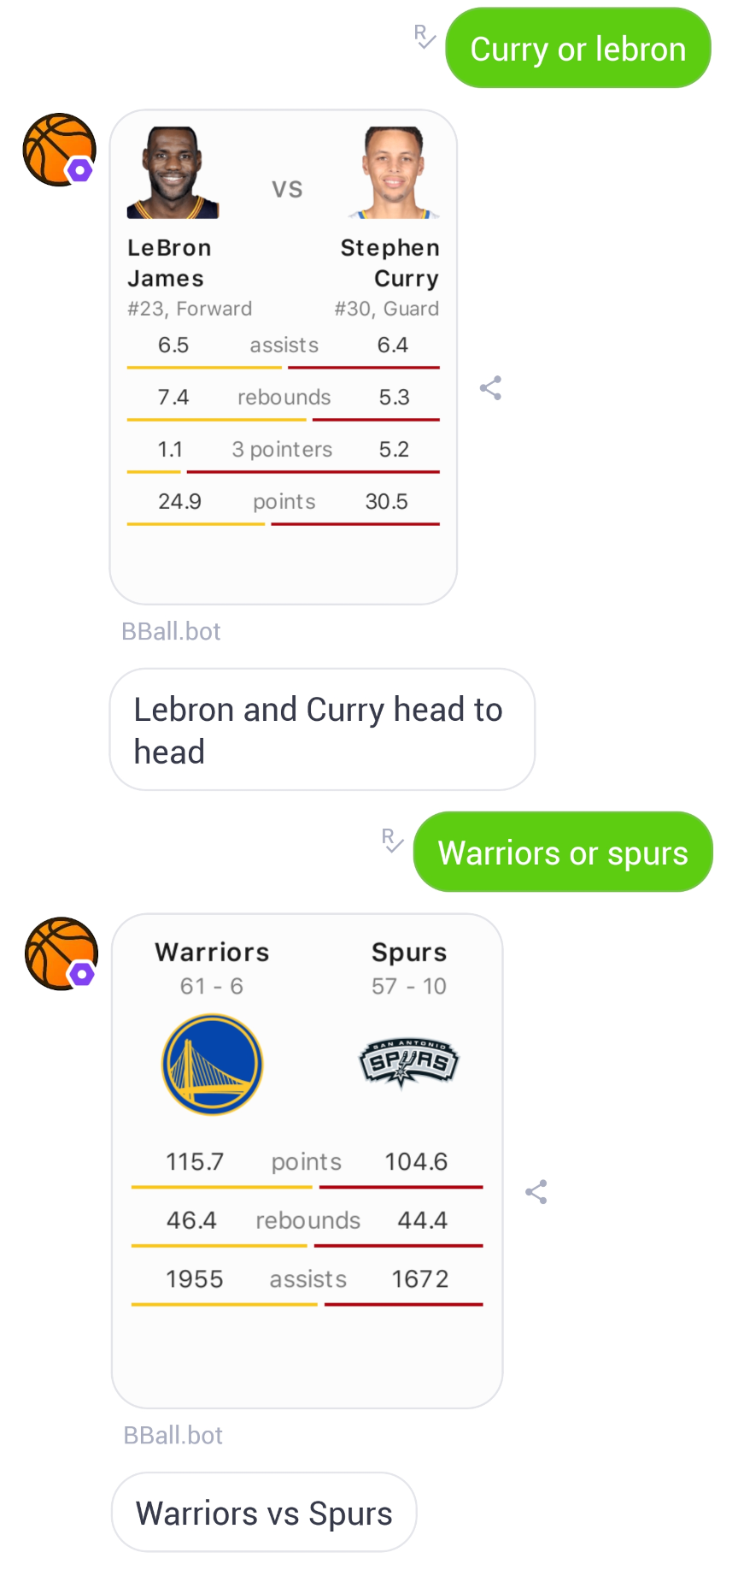
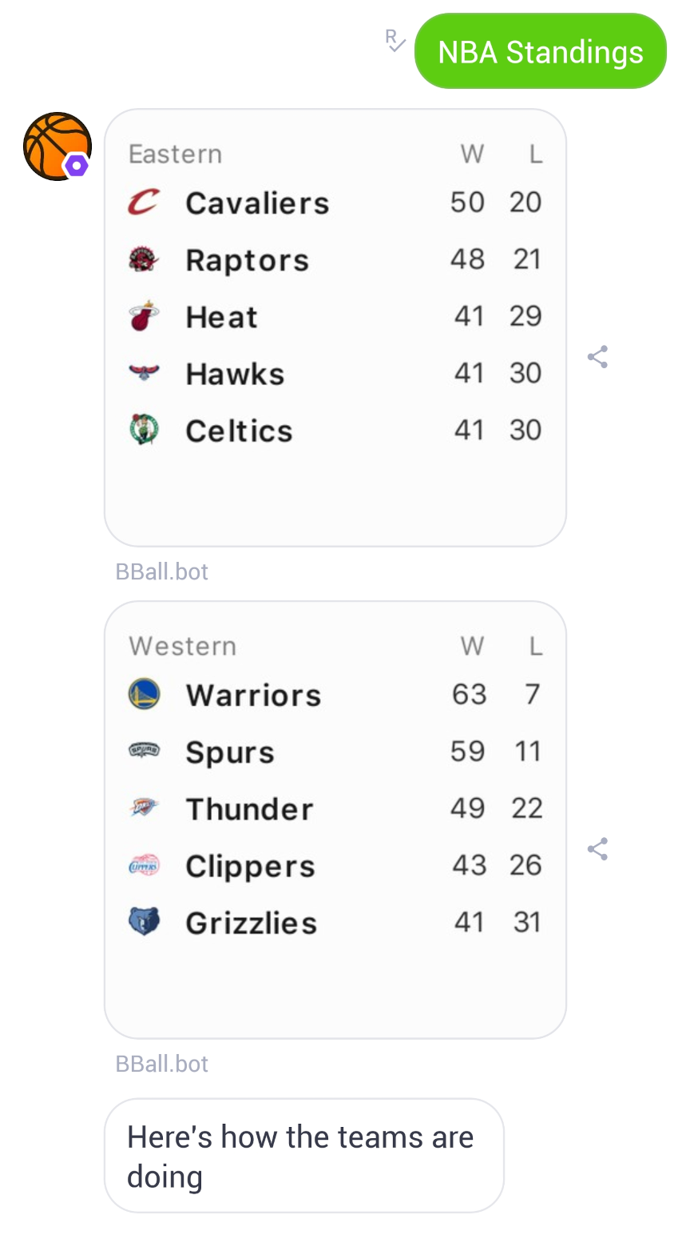
To:
Mya
Got bots on your mind, do you? Here’s a brief summary of what Michael has done.
any other relevant experience?
Bball Bot (3 of 4)
Michael’s experience from Yahoo! translated to his time at Walmart Labs.
Examples:
Head to Head Stats
  Player vs Player
  Team vs Team
NBA standings
  Limited to the top 5 of each conference due spacial restrictions
What bots did Michael work on at yahoo?
Here are the bots Michael worked on during his time at Yahoo!
tell me about the basketball bot mya
You remembered my name! How flattering! Check out Michael’s stat line for the Bball Bot; he did a bit of everything!

Slide 18
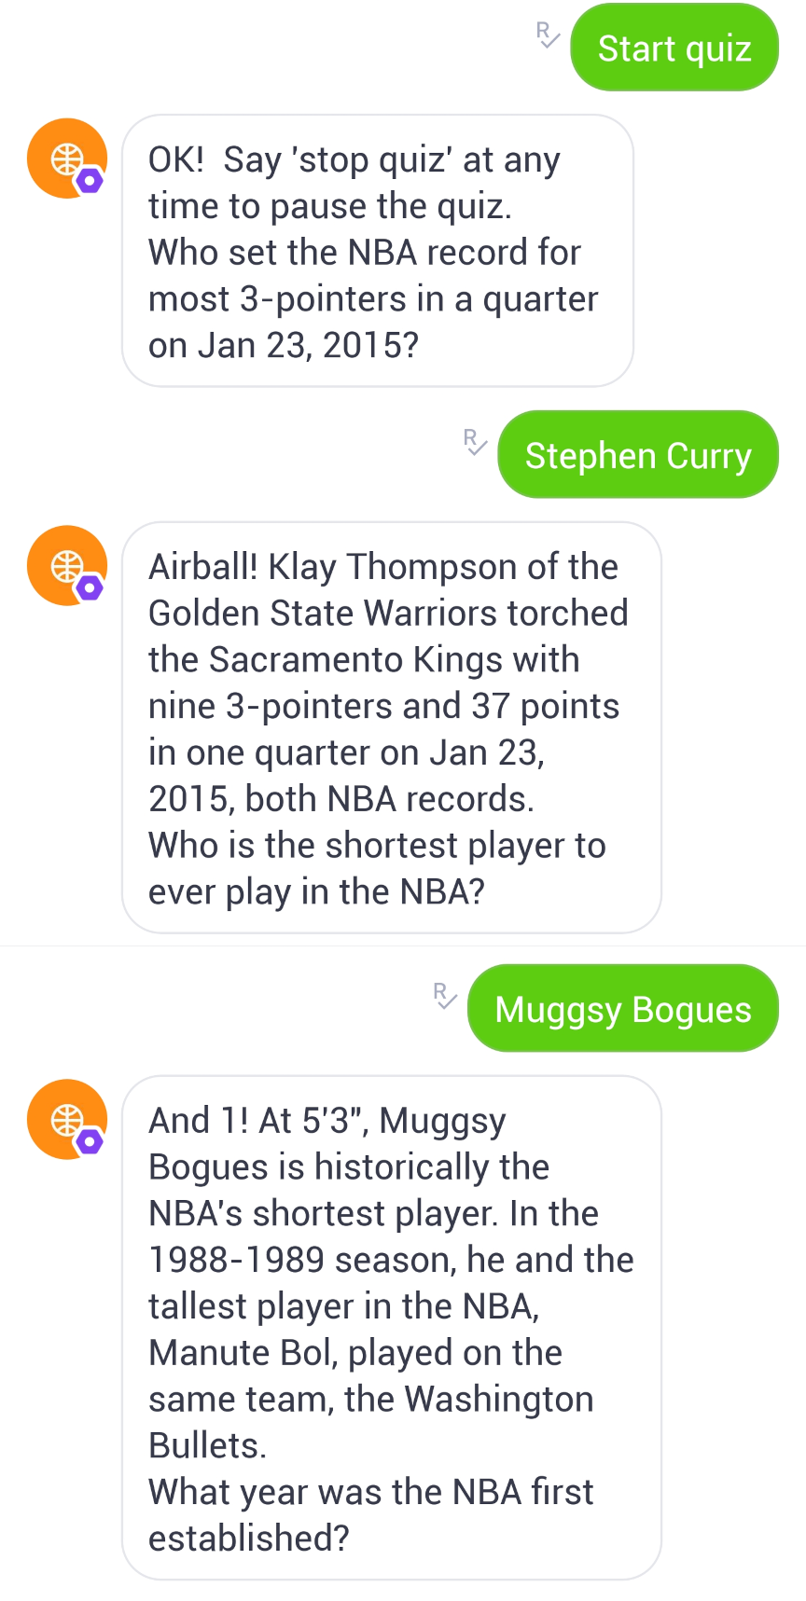
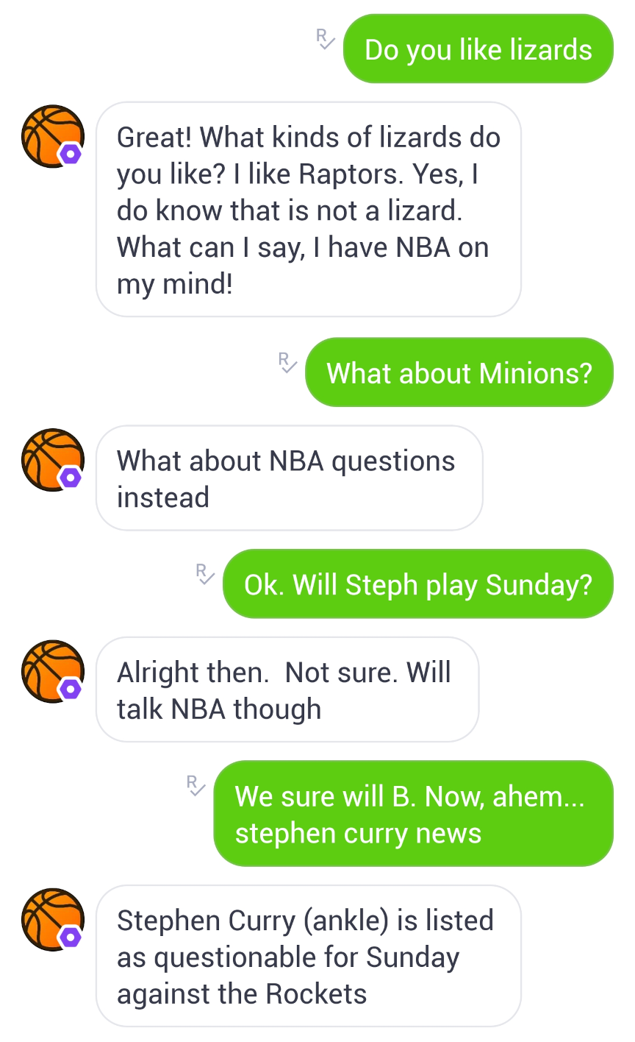
To:
Mya
Got bots on your mind, do you? Here’s a brief summary of what Michael has done.
any other relevant experience?
Bball Bot (4 of 4)
Michael’s experience from Yahoo! translated to his time at Walmart Labs.
Examples:
The quiz example illustrates the use of basketball slang to show personality. Incorrect answers yielded phrases like “Airball!” and “Rejected!” whereas correct answers resulted in responses like “And 1” and “Slam Dunk!”
Bball Bot steering conversation
What bots did Michael work on at yahoo?
Here are the bots Michael worked on during his time at Yahoo!
tell me about the basketball bot mya
You remembered my name! How flattering! Check out Michael’s stat line for the Bball Bot; he did a bit of everything!
show me the next example
show me the next example

Slide 19
To:
Mya
any other relevant experience?
Michael’s experience from Yahoo! translated to his time at Walmart Labs.
Bball Bot (4 of 4)
What bots did Michael work on at yahoo?
Examples:
The quiz example illustrates the use of basketball slang to show personality. Incorrect answers yielded phrases like “Airball!” and “Rejected!” whereas correct answers resulted in responses like “And 1” and “Slam Dunk!”
Bball Bot steering conversation
Here are the bots Michael worked on during his time at Yahoo!
tell me about the basketball bot mya
You remembered my name! How flattering! Check out Michael’s stat line for the Bball Bot; he did a bit of everything!
show me the next example
Bot is typing…

Slide 20
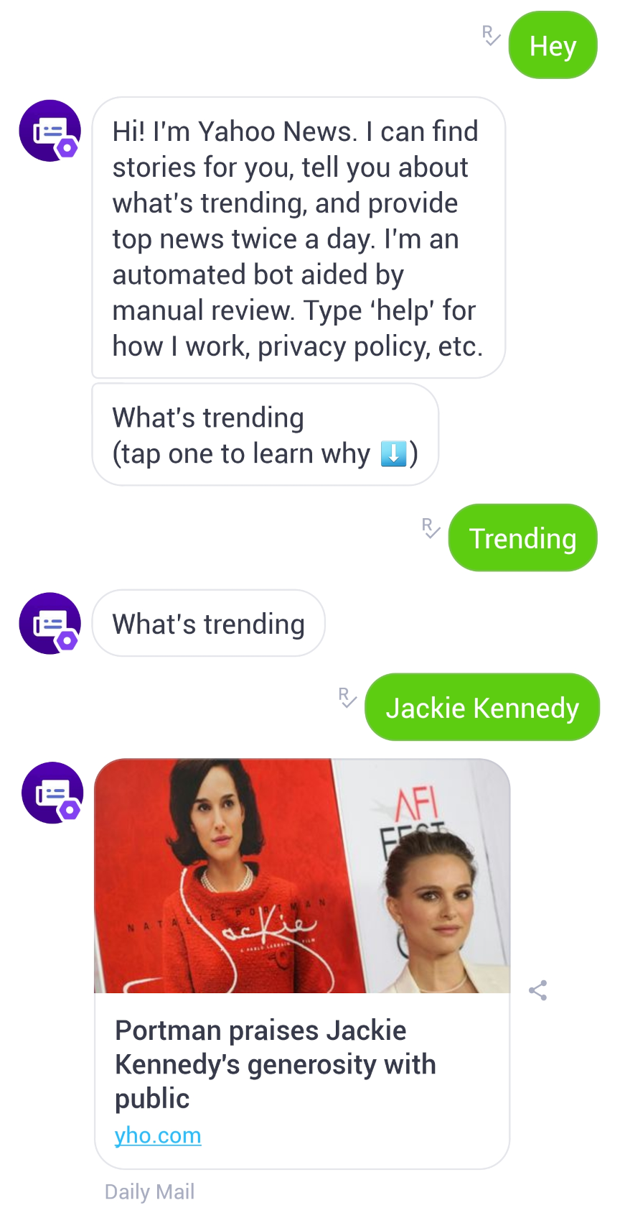
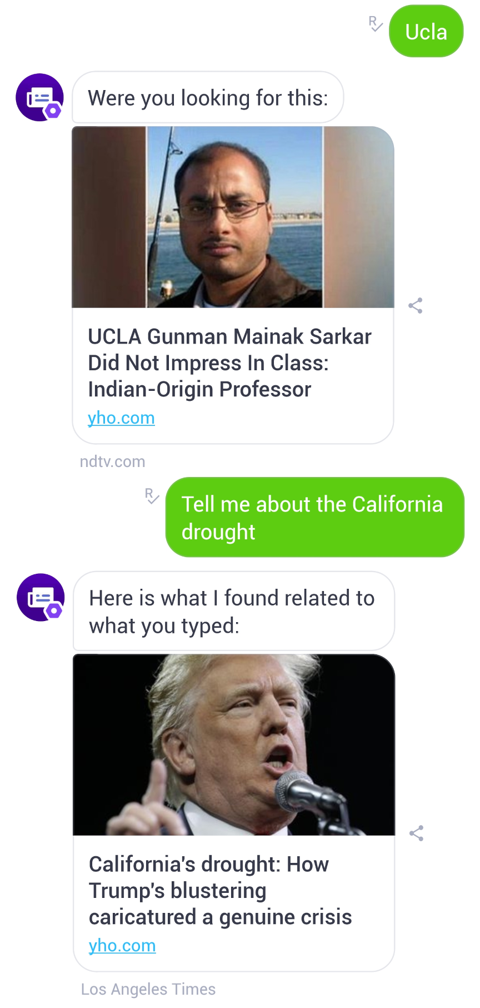
To:
Mya
Michael’s experience from Yahoo! translated to his time at Walmart Labs.
What bots did Michael work on at yahoo?
Yahoo News Bot
Here are the bots Michael worked on during his time at Yahoo!
Persona: Informational and direct
Function:
Current news
Offered suggestions
Promoted what was trending
Headlines
Story summaries
News according to user inquiry
Examples:
Interaction with buttons for trending news
Free text queries and results
tell me about the basketball bot mya
You remembered my name! How flattering! Check out Michael’s stat line for the Bball Bot; he did a bit of everything!
show me the next example
Michael made headlines with the Yahoo News Bot!
Next bot

Slide 21
To:
Mya
What bots did Michael work on at yahoo?
Here are the bots Michael worked on during his time at Yahoo!
Yahoo News Bot
tell me about the basketball bot mya
Persona: Informational and direct
Function:
Current news
Offered suggestions
Promoted what was trending
Headlines
Story summaries
News according to user inquiry
Examples:
Interaction with buttons for trending news
Free text queries and results
You remembered my name! How flattering! Check out Michael’s stat line for the Bball Bot; he did a bit of everything!
show me the next example
Michael made headlines with the Yahoo News Bot!
Next bot
Bot is typing…

Slide 22
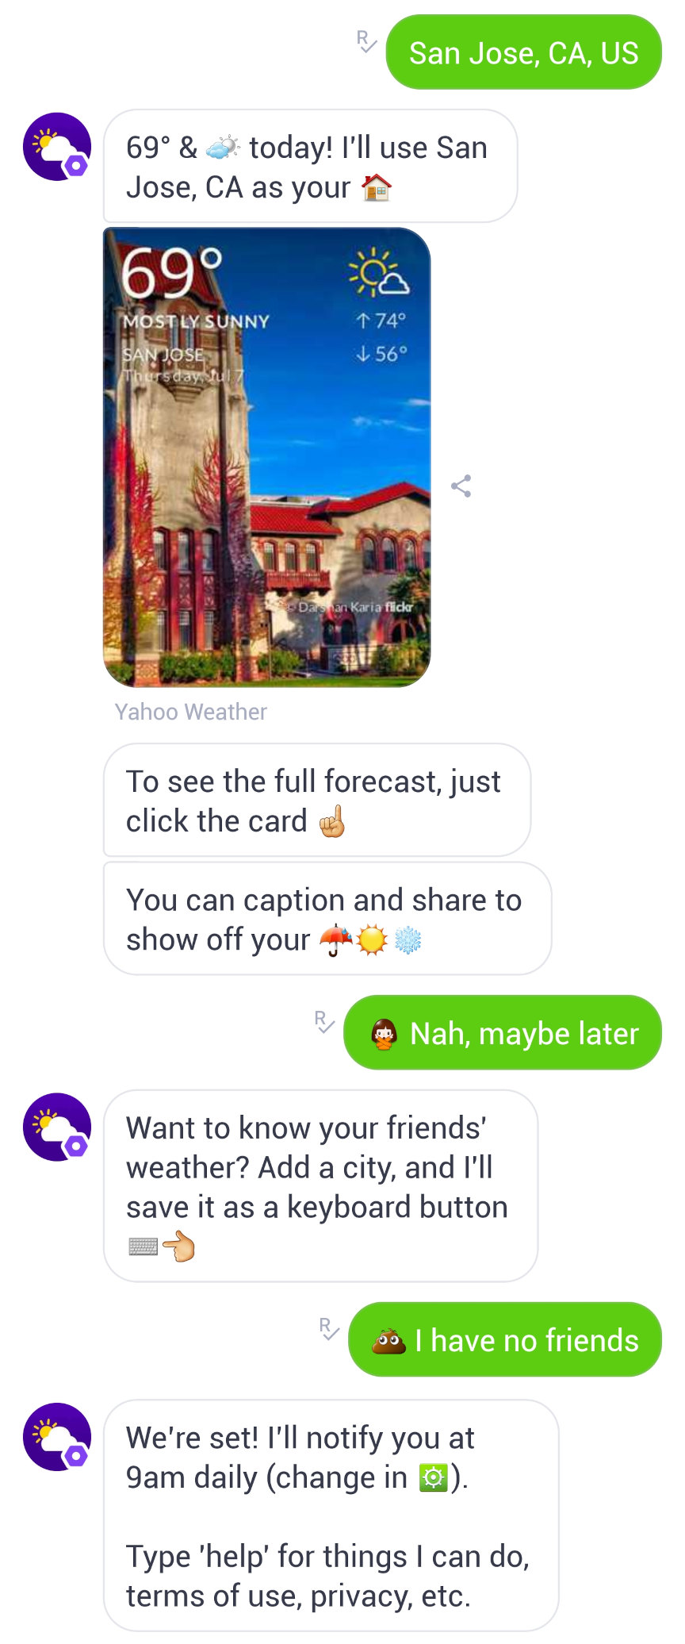
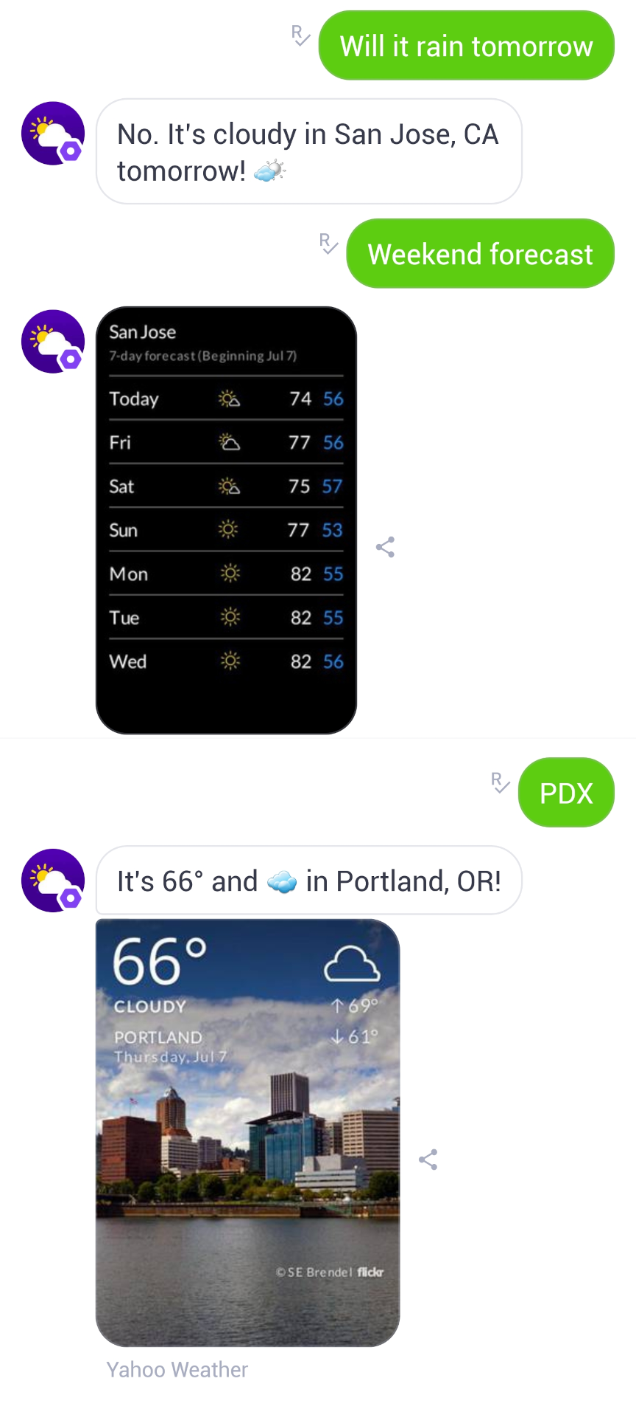
To:
Mya
Here are the bots Michael worked on during his time at Yahoo!
tell me about the basketball bot mya
Weather Bot
You remembered my name! How flattering! Check out Michael’s stat line for the Bball Bot; he did a bit of everything!
Persona: Informational and lighthearted
Function:
Current weather
Hourly, daily, and weekly forecasts
Saved locations and set notifications
Answered weather related questions
Provided forecasts based on user inquiry utilizing location tokens such as:
  Zip codes
  Airport codes
  Cities, counties, states, countries
Examples:
Setting primary weather location
Weather inquiries
show me the next example
Michael made headlines with the Yahoo News Bot!
Next bot
Michael was sunshine and rainbows when working on the Weather Bot!
what else is there?

Slide 23
To:
Mya
tell me about the basketball bot mya
You remembered my name! How flattering! Check out Michael’s stat line for the Bball Bot; he did a bit of everything!
Weather Bot
show me the next example
Persona: Informational and lighthearted
Function:
Current weather
Hourly, daily, and weekly forecasts
Saved locations and set notifications
Answered weather related questions
Provided forecasts based on user inquiry utilizing location tokens such as:
  Zip codes
  Airport codes
  Cities, counties, states, countries
Examples:
Setting primary weather location
Weather inquiries
Michael made headlines with the Yahoo News Bot!
Next bot
Michael was sunshine and rainbows when working on the Weather Bot!
what else is there?
Bot is typing…

Slide 24
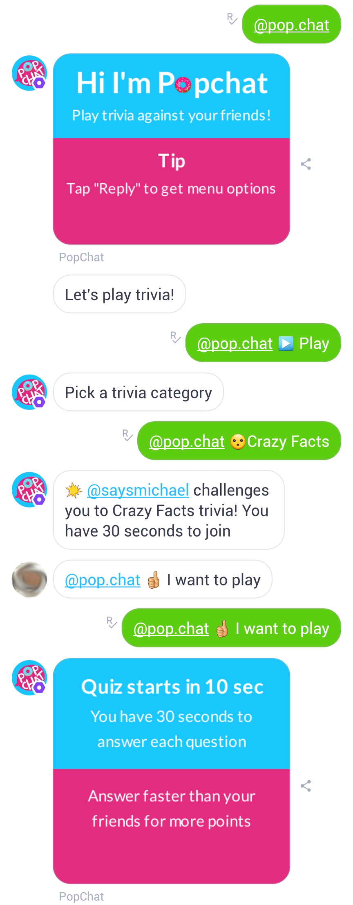
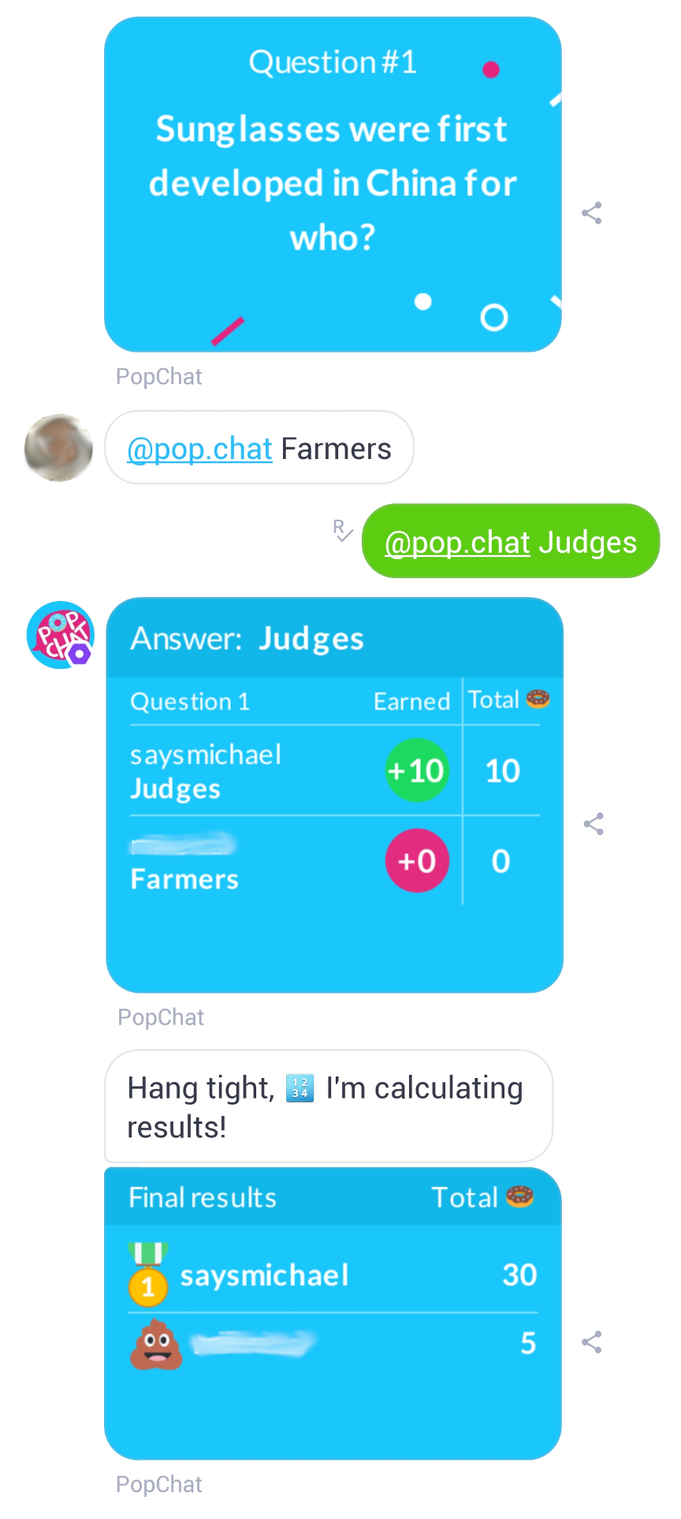
To:
Mya
You remembered my name! How flattering! Check out Michael’s stat line for the Bball Bot; he did a bit of everything!
Popchat (1 of 4)
show me the next example
Michael made headlines with the Yahoo News Bot!
Purpose: Game and activity bot. It was used as a standalone bot or called upon in chat sessions with users on platforms like Facebook messenger and Kik.
Function:
Trivia game
Meme generator
Drawing share
Story generator
Fun with images (image manipulator)
Example:
Trivia game with another user during a chat session on Kik
Next bot
Michael was sunshine and rainbows when working on the Weather Bot!
what else is there?
It was all fun and games when Michael wrote for Popchat! Take a peek at some writing samples.

Slide 25
To:
Mya
You remembered my name! How flattering! Check out Michael’s stat line for the Bball Bot; he did a bit of everything!
Popchat (2 of 4)
show me the next example
Michael made headlines with the Yahoo News Bot!
Meme Generator
Good Guy Memes
“Car breaks down”, “Tips tow truck driver”
“Gets rejected”, “Appreciates the honesty”
“Stops at a yellow light”
“Always loses at Cards Against Humanity”
Conspiracy Memes
“What if deleting your history erases your memories?”
“What if the tongue of your shoes always tastes your feet?”
“What if people stopped using words? NNTR.”
Scumbag Memes
“Calls a helpline”, “Talks about football”
“Enters a footrace”, “For kids”
“There are no stupid questions”, “Only stupid people”
Bad Luck Memes
“Paid off driving lessons”, “Didn’t bring golf clubs”
“Won the lottery”, “Like the one from the story”
“Went to a dating website”, “Got a virus”
Random Memes
“Russian dolls are so full of themselves”
“Colonels hate phonics”
Next bot
Michael was sunshine and rainbows when working on the Weather Bot!
what else is there?
It was all fun and games when Michael wrote for Popchat! Take a peek at some writing samples.

Slide 26
To:
Mya
You remembered my name! How flattering! Check out Michael’s stat line for the Bball Bot; he did a bit of everything!
Popchat (3 of 4)
show me the next example
Michael made headlines with the Yahoo News Bot!
Trivia Questions
Question | Answer 1 | Answer 2 | Answer 3 | Answer 4 (correct)
Kobe Bryant was named after Kobe beef. What's his middle name? | Kale | Clam | Dip | Bean
The first production electric car was introduced when? | 2004 | 1992 | 1901 | 1884
Who was not a Spice Girl? | Scary Spice | Posh Spice | Baby Spice | Garlic Spice
Which of these names does not belong here? | Slim Shady | Marshall Mathers | Eminem | Fatboy Slim
Is a hot dog a sandwich? | Yes | No | Sometimes | Who knows?
How much blood does the heart pump through an adult body every day? | 757 gallons | 1,200 gallons | 1,700 gallons | 2,000 gallons
After reading this sentence, you will come to realize that the the brain skips over the second _______. | Word | Letter | Comma | The
Antarctica is the largest desert in the world. | TRUE | FALSE |  | TRUE
Oxford University is NOT older than which of these? | The Aztecs | The Inca Empire | Books | Cooking Pots
Next bot
Michael was sunshine and rainbows when working on the Weather Bot!
what else is there?
It was all fun and games when Michael wrote for Popchat! Take a peek at some writing samples.

Slide 27
To:
Mya
You remembered my name! How flattering! Check out Michael’s stat line for the Bball Bot; he did a bit of everything!
Popchat (4 of 4)
show me the next example
Michael made headlines with the Yahoo News Bot!
Story Generator
Phrases | Blanks
He looks to the [1], then [2], and became confident he would win. "I'll raise a(n) [3]" he says. The man to his left stares at him [4] and finally says, "I'll see your [3] and raise you a(n) [5]." They look to the woman on the right as she sits there, [6]. "Doesn't anyone play for money anymore?" she bursts. | 1. a direction 2. another direction 3. an article of clothing 4. an adverb 5. a computer accessory 6. a negative expression
Knock Knock. Who's there? [1]. [1] who? [1] [2] [3] [4] [5] too! That makes no sense... and I hate you. | 1. a noun 2. a verb 3. an adjective 4. a distance 5. a place
[1] was a contractor that put up a fence. Little did he know, his [2] brain was quite dense. The whole thing was made of [3], hence the reason he's been a [4] ever since. | 1. a male name 2. a size 3. a food 4. an occupation
"It must've been a dream within a dream within a dream within a dream," [1] thought. Why else would [2] be [3] above [4] in [5] while [6] trade [7] with [8] to collect [9]? | 1. a person's name 2. a type of vehicle (plural) 3. an action ending with "ing" 4. a type of building (plural) 5. a country 6. a monster (plural) 7. a noun (plural) 8. an occupation (plural) 9. a type of toy (plural)
Next bot
Michael was sunshine and rainbows when working on the Weather Bot!
what else is there?
It was all fun and games when Michael wrote for Popchat! Take a peek at some writing samples.
Show me 1 more

Slide 28
To:
Mya
You remembered my name! How flattering! Check out Michael’s stat line for the Bball Bot; he did a bit of everything!
Popchat (4 of 4)
show me the next example
Michael made headlines with the Yahoo News Bot!
Story Generator
Next bot
Phrases | Blanks
He looks to the [1], then [2], and became confident he would win. "I'll raise a(n) [3]" he says. The man to his left stares at him [4] and finally says, "I'll see your [3] and raise you a(n) [5]." They look to the woman on the right as she sits there, [6]. "Doesn't anyone play for money anymore?" she bursts. | 1. a direction 2. another direction 3. an article of clothing 4. an adverb 5. a computer accessory 6. a negative expression
Knock Knock. Who's there? [1]. [1] who? [1] [2] [3] [4] [5] too! That makes no sense... and I hate you. | 1. a noun 2. a verb 3. an adjective 4. a distance 5. a place
[1] was a contractor that put up a fence. Little did he know, his [2] brain was quite dense. The whole thing was made of [3], hence the reason he's been a [4] ever since. | 1. a male name 2. a size 3. a food 4. an occupation
"It must've been a dream within a dream within a dream within a dream," [1] thought. Why else would [2] be [3] above [4] in [5] while [6] trade [7] with [8] to collect [9]? | 1. a person's name 2. a type of vehicle (plural) 3. an action ending with "ing" 4. a type of building (plural) 5. a country 6. a monster (plural) 7. a noun (plural) 8. an occupation (plural) 9. a type of toy (plural)
Michael was sunshine and rainbows when working on the Weather Bot!
what else is there?
It was all fun and games when Michael wrote for Popchat! Take a peek at some writing samples.
Show me 1 more
Bot is typing…

Slide 29
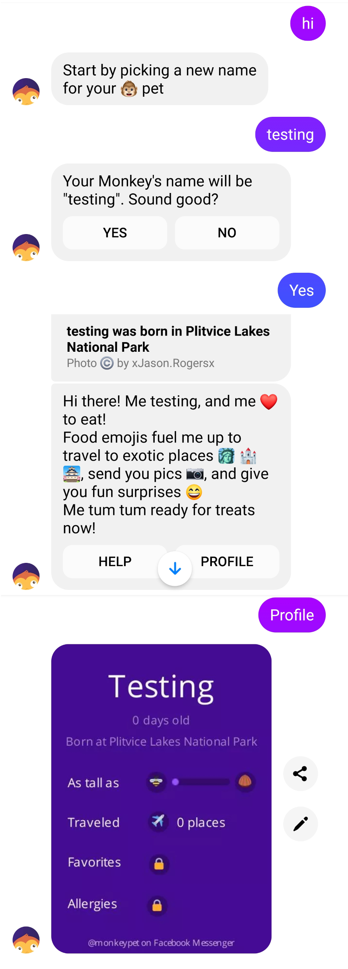
You remembered my name! How flattering! Check out Michael’s stat line for the Bball Bot; he did a bit of everything!
To:
Mya
show me the next example
Michael made headlines with the Yahoo News Bot!
Monkey Pets (1 of 3)
Next bot
Inception: Initial design was intended for a younger audience. The user would feed their pet food emojis and watch it grow.
Persona: Childlike and interacts with emojis. Good at deflecting vulgar, violent, and suggestive language while staying upbeat.
Expansion: The scope of Monkey Pets widened drastically. Although it retained its childlike nature, it became quite the sophisticated bot, leveraging the development of other bots to become a multifunctional, multipurpose bot.
Example:
Onboarding (Facebook)
Michael was sunshine and rainbows when working on the Weather Bot!
what else is there?
It was all fun and games when Michael wrote for Popchat! Take a peek at some writing samples.
Show me 1 more
Designing for Monkey Pets was a breeze for Michael, considering he was born year of the Monkey!

Slide 30
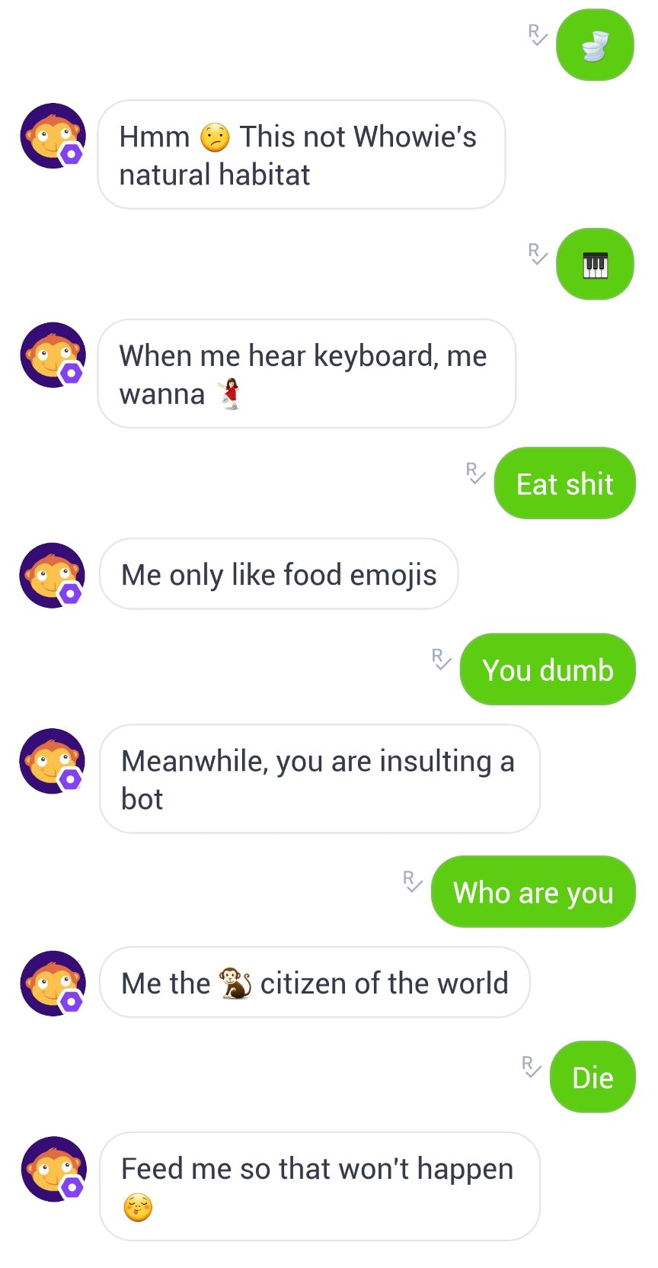
You remembered my name! How flattering! Check out Michael’s stat line for the Bball Bot; he did a bit of everything!
To:
Mya
show me the next example
Michael made headlines with the Yahoo News Bot!
Monkey Pets (2 of 3)
Next bot
Function:
Interaction by feeding emojis and chatting with it
Posted images requested by user
Played gifs and videos requested by user
Traveled to locations virtually
Leveraged weather bot for current weather, news bot for local affairs, and image function for local images
Standalone bot or interacted with other users in chat sessions when called upon
Example:
Monkey Pets interacting with emojis and deflecting negative language
Michael was sunshine and rainbows when working on the Weather Bot!
what else is there?
It was all fun and games when Michael wrote for Popchat! Take a peek at some writing samples.
Show me 1 more
Designing for Monkey Pets was a breeze for Michael, considering he was born year of the Monkey!

Slide 31
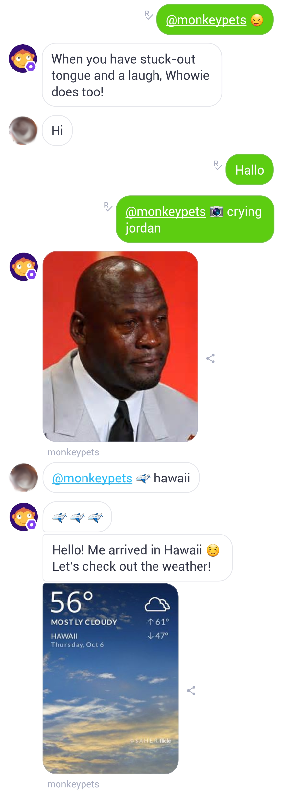
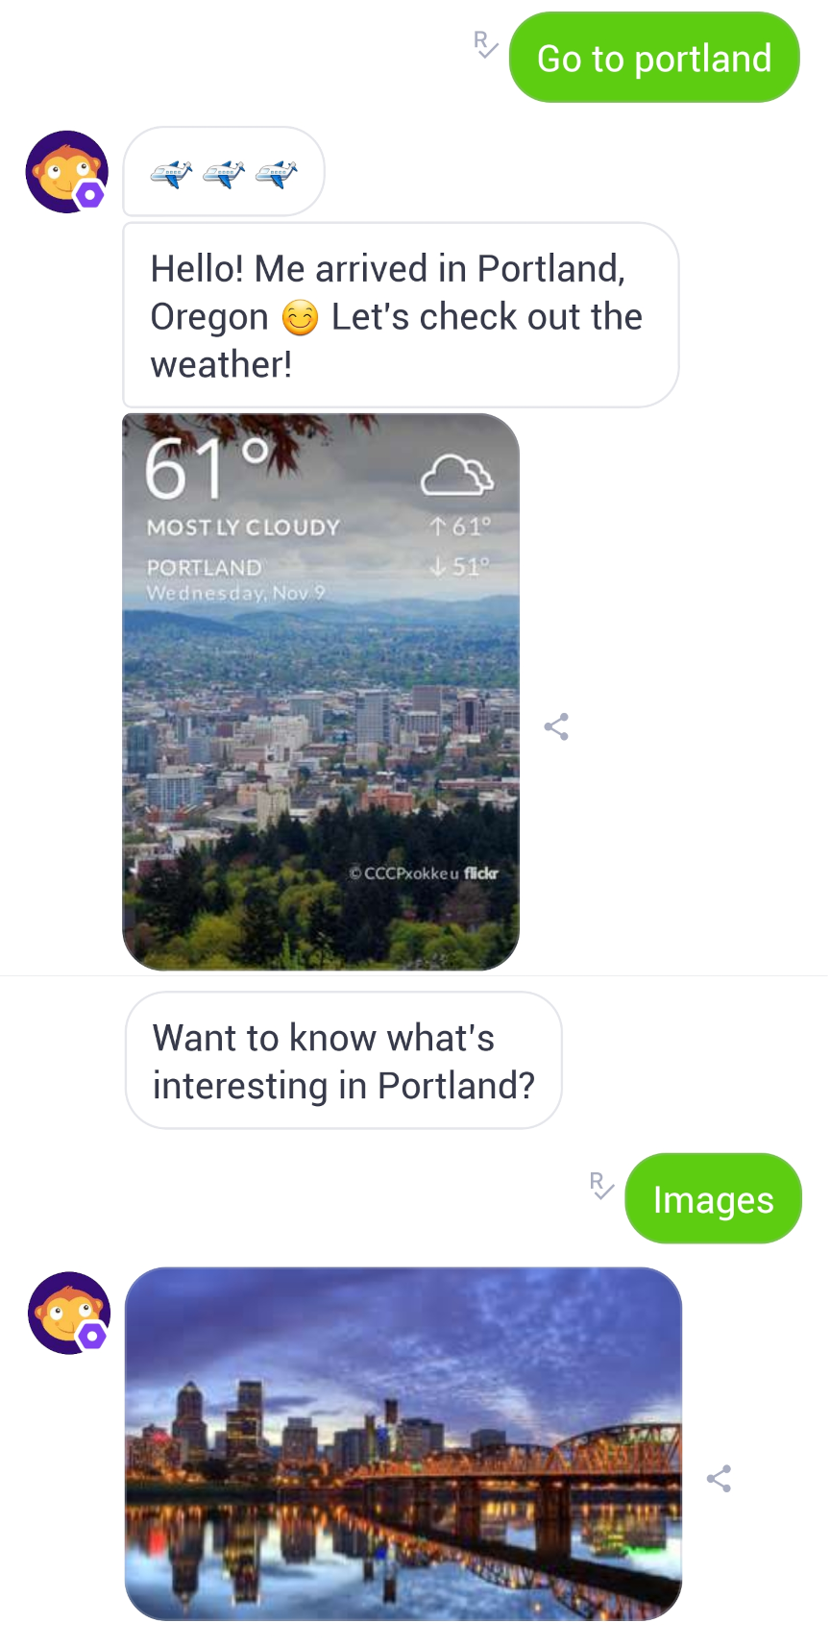
You remembered my name! How flattering! Check out Michael’s stat line for the Bball Bot; he did a bit of everything!
To:
Mya
show me the next example
Michael made headlines with the Yahoo News Bot!
Monkey Pets (3 of 3)
Next bot
Examples:
Leveraging weather bot and image function for travel feature
Monkey Pets interaction with another user via Kik chat session
Example:
Leveraging weather bot and Monkey Pets functions
Interaction with another user via Kik chat session
Michael was sunshine and rainbows when working on the Weather Bot!
what else is there?
It was all fun and games when Michael wrote for Popchat! Take a peek at some writing samples.
Show me 1 more
Designing for Monkey Pets was a breeze for Michael, considering he was born year of the Monkey!
…bots to see how they work?

Slide 32
To:
Mya
show me the next example
Michael made headlines with the Yahoo News Bot!
Monkey Pets (3 of 3)
Next bot
Michael was sunshine and rainbows when working on the Weather Bot!
Examples:
Leveraging weather bot and image function for travel feature
Monkey Pets interaction with another user via Kik chat session
Example:
Leveraging weather bot and Monkey Pets functions
Interaction with another user via Kik chat session
what else is there?
It was all fun and games when Michael wrote for Popchat! Take a peek at some writing samples.
Show me 1 more
Designing for Monkey Pets was a breeze for Michael, considering he was born year of the Monkey!
Can I demo any of these bots to see how they work?
Bot is typing…

Slide 33
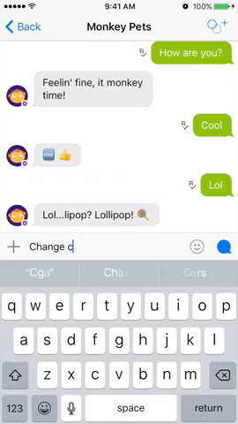
Michael made headlines with the Yahoo New Bot!
To:
Mya
Next bot
Michael was sunshine and rainbows when working on the Weather Bot!
Monkey Pets Video Demos (1 of 4)
what else is there?
It was all fun and games when Michael wrote for Popchat! Take a peek at some writing samples.
Example:
Customizing your pet monkey and increasing monkey stats
Click to play (or press →)
* Audio turned off as default
Example:
Leveraging weather bot and Monkey Pets functions
Interaction with another user via Kik chat session
Show me 1 more
Designing for Monkey Pets was a breeze for Michael, considering he was born year of the Monkey!
Can I demo any of these bots to see how they work?
Unfortunately, these bots are no longer live. However, you can watch these video demos of Monkey Pets!

Slide 34
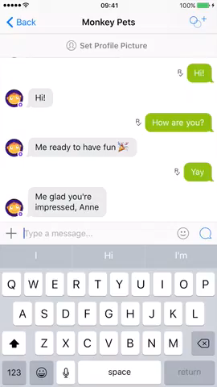
Michael made headlines with the Yahoo New Bot!
To:
Mya
Next bot
Michael was sunshine and rainbows when working on the Weather Bot!
Monkey Pets Video Demos (2 of 4)
what else is there?
It was all fun and games when Michael wrote for Popchat! Take a peek at some writing samples.
Example:
Featured skills for Monkey Pets
Interaction with emojis
Click to play (or press →)
* Audio turned off as default
Example:
Leveraging weather bot and Monkey Pets functions
Interaction with another user via Kik chat session
Show me 1 more
Designing for Monkey Pets was a breeze for Michael, considering he was born year of the Monkey!
Can I demo any of these bots to see how they work?
Unfortunately, these bots are no longer live. However, you can watch these video demos of Monkey Pets!

Slide 35
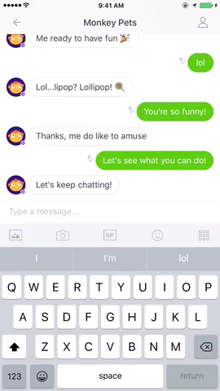
To:
Mya
Next bot
Michael was sunshine and rainbows when working on the Weather Bot!
Monkey Pets Video Demos (3 of 4)
what else is there?
It was all fun and games when Michael wrote for Popchat! Take a peek at some writing samples.
Example:
Natural language messaging queries
  Results include buttons with suggestions
Click to play (or press →)
* Audio turned off as default
Example:
Leveraging weather bot and Monkey Pets functions
Interaction with another user via Kik chat session
Show me 1 more
Designing for Monkey Pets was a breeze for Michael, considering he was born year of the Monkey!
Can I demo any of these bots to see how they work?
Unfortunately, these bots are no longer live. However, you can watch these video demos of Monkey Pets!

Slide 36
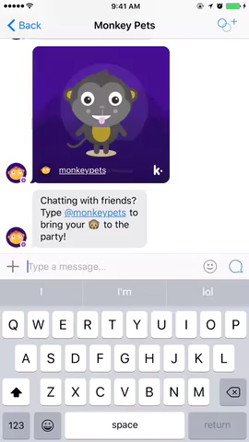
Michael made headlines with the Yahoo New Bot!
To:
Mya
Next bot
Michael was sunshine and rainbows when working on the Weather Bot!
Monkey Pets Video Demos (4 of 4)
what else is there?
It was all fun and games when Michael wrote for Popchat! Take a peek at some writing samples.
Example:
Interacting with Monkey Pets with other users in Kik session
Click to play (or press →)
* Audio turned off as default
Example:
Leveraging weather bot and Monkey Pets functions
Interaction with another user via Kik chat session
Show me 1 more
Designing for Monkey Pets was a breeze for Michael, considering he was born year of the Monkey!
Can I demo any of these bots to see how they work?
Unfortunately, these bots are no longer live. However, you can watch these video demos of Monkey Pets!
…seen enough Mya.. Thanks!

Slide 37
To:
Mya
Michael was sunshine and rainbows when working on the Weather Bot!
what else is there?
Monkey Pets Video Demos (4 of 4)
It was all fun and games when Michael wrote for Popchat! Take a peek at some writing samples.
Example:
Interacting with Monkey Pets with other users in Kik session
Click to play (or press →)
* Audio turned off as default
Example:
Leveraging weather bot and Monkey Pets functions
Interaction with another user via Kik chat session
Show me 1 more
Designing for Monkey Pets was a breeze for Michael, considering he was born year of the Monkey!
Can I demo any of these bots to see how they work?
Unfortunately, these bots are no longer live. However, you can watch these video demos of Monkey Pets!
I think I’ve seen enough Mya. Are you anything like Michael?
Bot is typing…

Slide 38

To:
Mya
Show me 1 more
Designing for Monkey Pets was a breeze for Michael, considering he was born year of the Monkey!
Michael Yen’s Assistant (Mya)
Can I demo any of these bots to see how they work?
Persona: Informative, fun, spunky
Function:
Be smarter than Michael
Be prettier than Michael
Speak straight facts
Unfortunately, these bots are no longer live. However, you can watch these video demos of Monkey Pets!
Example:
Leveraging weather bot and Monkey Pets functions
Interaction with another user via Kik chat session
I think I’ve seen enough Mya. Are you anything like Michael?
I’m a smarter, prettier version.
…know. Can I get his information?

Slide 39
Designing Monkey Pets was a breeze for Michael, considering he was born year of the Monkey!
To:
Mya
Can I demo any of these bots to see how they work?
Michael Yen’s Assistant (Mya)
Unfortunately, these bots are no longer live. However, you can watch these video demos of Monkey Pets!
I think I’ve seen enough Mya. Are you anything like Michael?
Persona: Informative, fun, spunky
Function:
Be smarter than Michael
Be prettier than Michael
Speak straight facts
Example:
Leveraging weather bot and Monkey Pets functions
Interaction with another user via Kik chat session
I’m a smarter, prettier version.
Lol. Good to know. Can I get his information?
Bot is typing…

Slide 40
To:
Mya
Unfortunately, these bots are no longer live. However, you can watch these video demos of Monkey Pets!
I think I’ve seen enough Mya. Are you anything like Michael?
Contact Information
I’m a smarter, prettier version.
Michael Yen
6212 Hopi Cir, San Jose, CA, 95123
408.515.5754
michaeljsyen@gmail.com
https://www.linkedin.com/in/michaeljsyen/
Example:
Leveraging weather bot and Monkey Pets functions
Interaction with another user via Kik chat session
Lol. Good to know. Can I get his information?
Absolutely! Between you and me, he can use a few more friends.
…for your help! So long Mya.

Slide 41
To:
Mya
I think I’ve seen enough Mya. Are you anything like Michael?
I’m a smarter, prettier version.
Contact Information
Michael Yen
6212 Hopi Cir, San Jose, CA, 95123
408.515.5754
michaeljsyen@gmail.com
https://www.linkedin.com/in/michaeljsyen/
Example:
Leveraging weather bot and Monkey Pets functions
Interaction with another user via Kik chat session
Lol. Good to know. Can I get his information?
Absolutely! Between you and me, he can use a few more friends.
Hahaha. Thanks for your help! So long Mya.
Bot is typing…

Slide 42

To:
Mya
I’m a smarter, prettier version.
Example:
Leveraging weather bot and Monkey Pets functions
Interaction with another user via Kik chat session
Lol. Good to know. Can I get his information?
Absolutely! Between you and me, he can use a few more friends.
Hahaha. Thanks for your help! So long Mya.
It’s been a pleasure Mx. Smiley! Have a beautiful day!
Bot is typing…

